Slide 1

Why Wait?
Teaching Research Skills to
Younger Students
An Action Research Project
for Roland Park Country School

Slide 2
“Research is formalized curiosity.
It is poking
and prying with a purpose.”
~Zora Neale Hurston

Slide 3
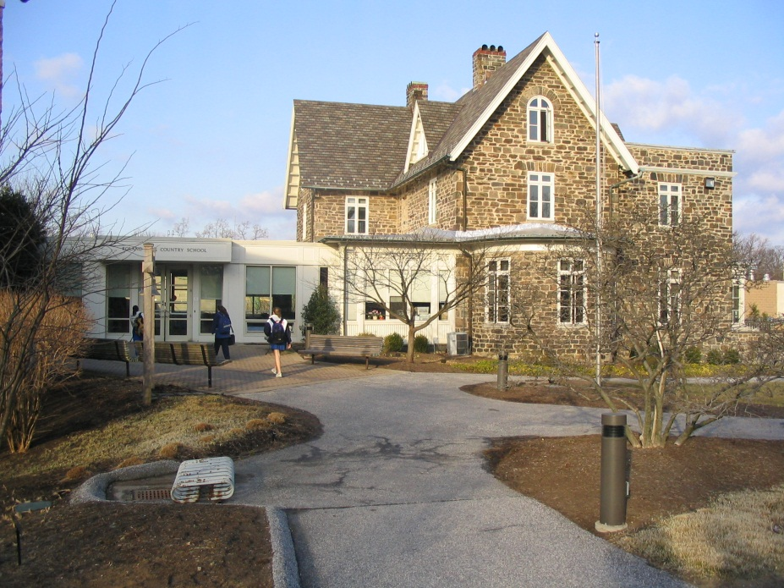

PURPOSE OF PROJECT
At RPCS, our goal is to produce lifelong learners...

Slide 4



…and according to the Standards of the American Association of School Librarians:
“Inquiry provides a framework for learning.”
=

Slide 5
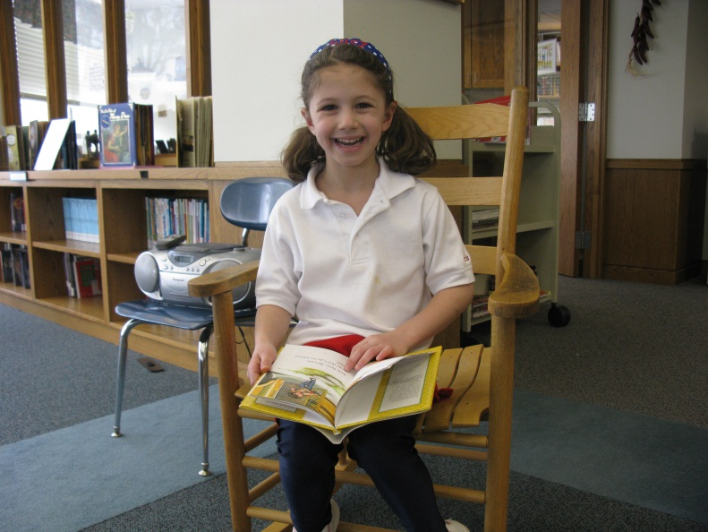
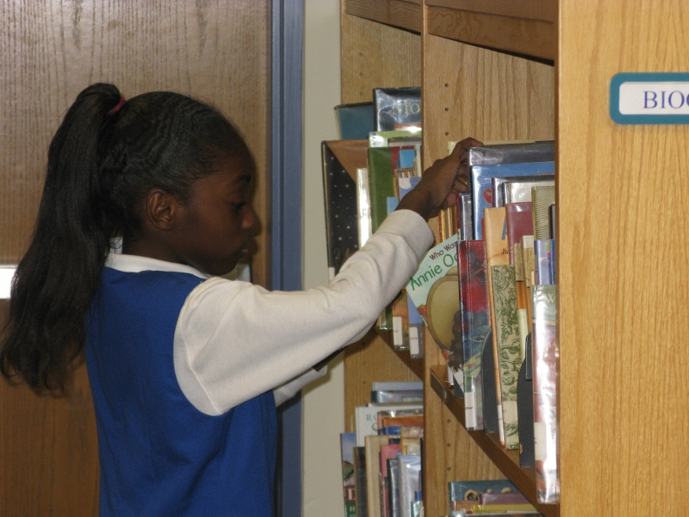
Inquiry-based learning is infused throughout the curriculum for RPCS students in grades 3 through 12, but what about our youngest crowd…
…in first and second grades?

Slide 6
Questions to Ponder…
Can research skills be taught to students of this age?
Would adding these skills to the curriculum be a worthwhile exercise that would have an impact on student achievement?

Slide 7
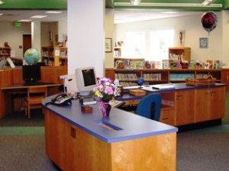
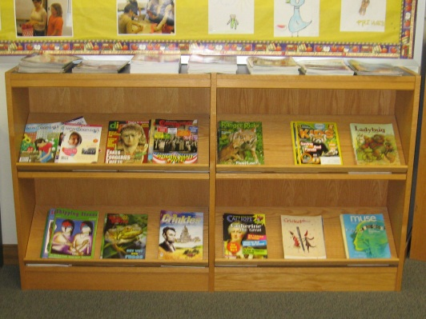
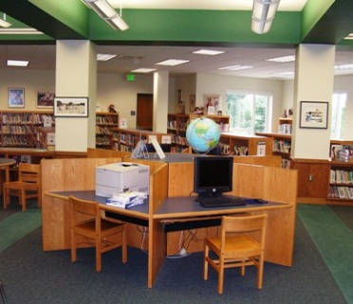
IF the answers are yes…
Then the RPCS Lower School Library wants to support the teaching of these skills!

Slide 8
Problem statement
Proposed by Beverly Edwards
Lower School Librarian
As the Lower School Librarian at Roland Park Country School, I currently teach research skills to students in grades 3-5, but I do not address any research skills with younger students, particularly first and second graders. I have learned that there are other schools in which lessons on basic research skills are taught at an early age. I need to know if adding these skills to the curriculum would be a worthwhile exercise that would have an impact on the students’ academic achievement.

Slide 9
Research questions
What research skills do the first and second grade teachers want the librarian to teach?
What are librarians in other private schools in Maryland teaching their first and second graders with regard to inquiry-based research?

Slide 10

What does the Literature Say?
There are two popular inquiry-based approaches that work very well with younger students:
I-search
Big6

Slide 11
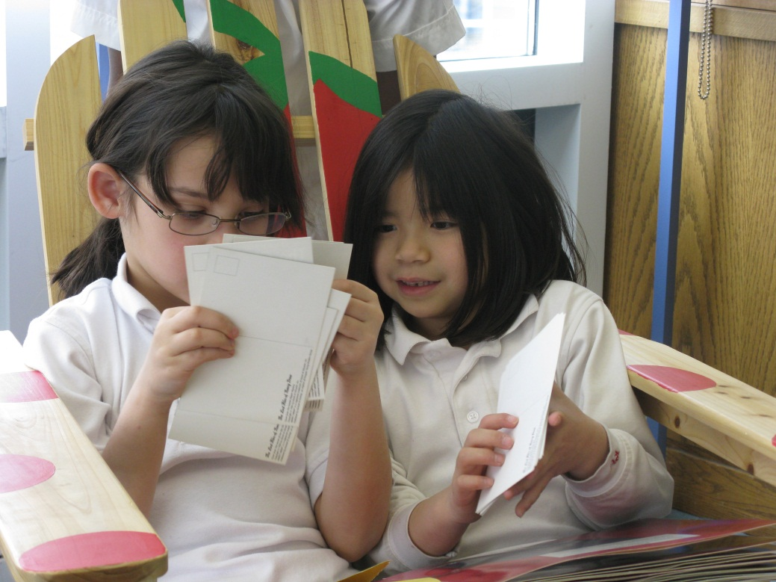
Students are well-suited for conducting basic research at an early age:
High energy level
Enthusiasm
Naturally curious

Slide 12
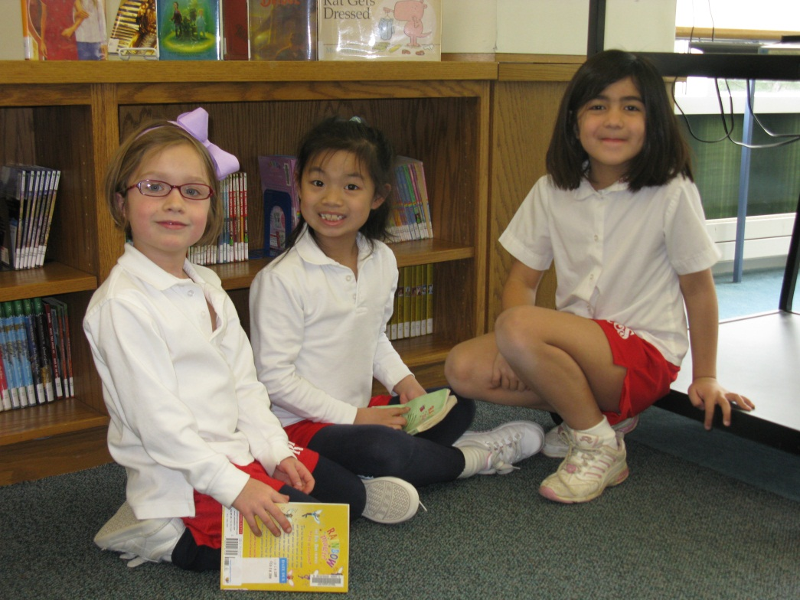
There are specific values and benefits for young learners who become beginning researchers.

Slide 13
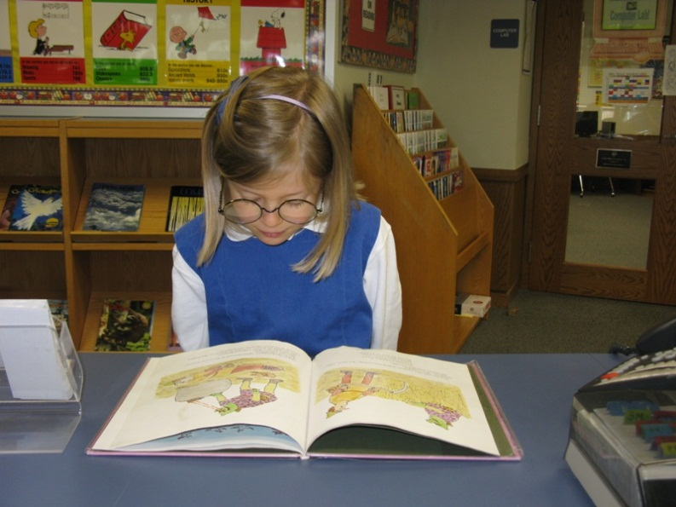
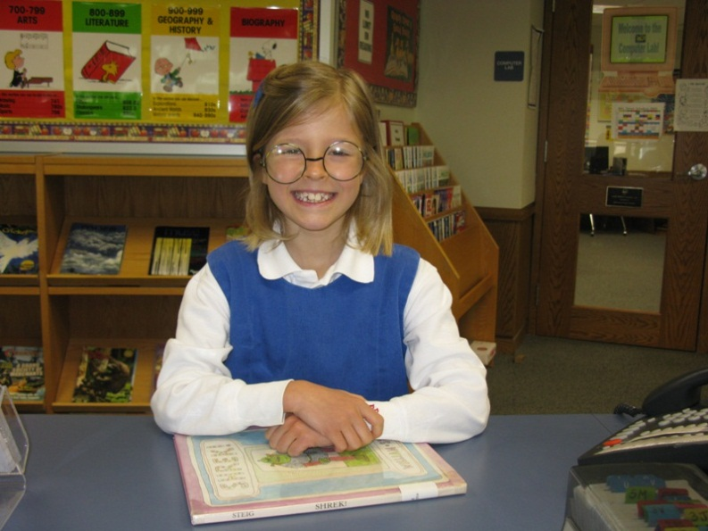
AN OVERVIEW
OF WHAT THE LITERATURE SAYS
IN WEB FORMAT…

Slide 14
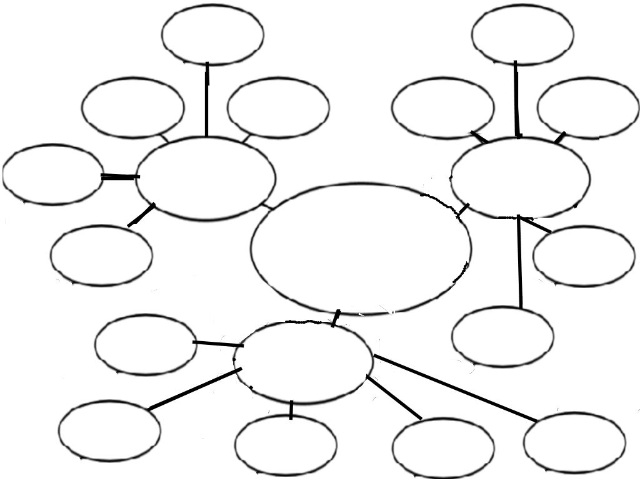
Generic
Intrinsic process
Outcomes can vary
Suited to collaboration
Ownership & empowerment
4 questions appropriate for all levels
Emphasis on information problem solving
Big 6
I-search
RESEARCH SKILLS for 1st and 2nd GRADERS
Flexible and adaptable
Reflective journaling
Values and benefits
Choose topic of interest
Active process
Proven to work
Early learners sustain interest
Self-directed and satisfying
Meaningful connections

Slide 15
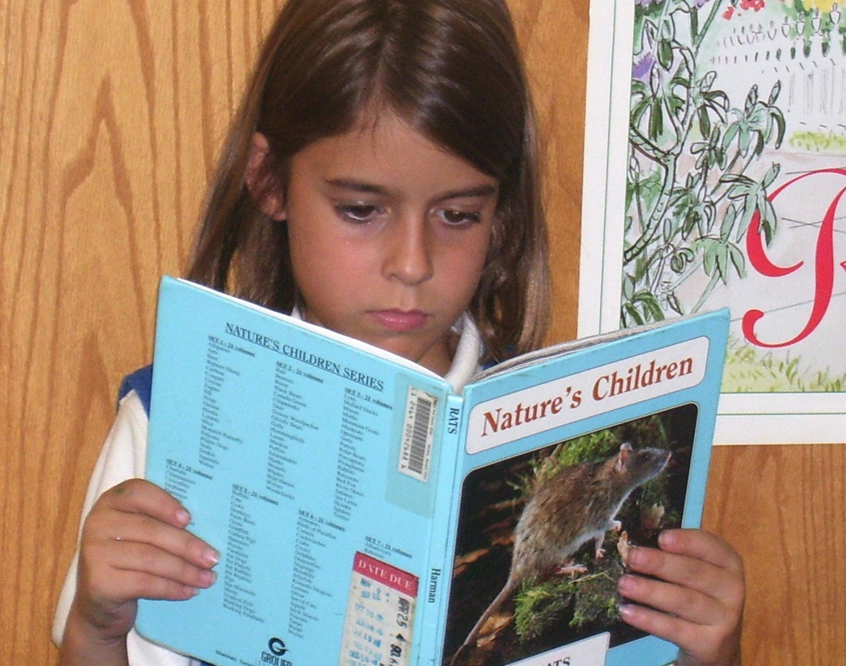
The RESEARCH PLAN
How Data Will Be Collected

Slide 16
Data Research Matrix
Research Question(s) | Data Source 1 | Data Source 2 | Data Source 3
1. What research skills do the first and second grade teachers want the librarian to teach? | Interview of first and second grade teachers | Analysis of teachers’ curriculum maps and lesson plans | Analysis of AASL Standards
2. What are librarians in other private schools in Maryland teaching their first and second graders with regard to inquiry-based research? | Survey of librarians | Analysis of librarians’ lesson plans and observations | Analysis of AASL Standards

Slide 17

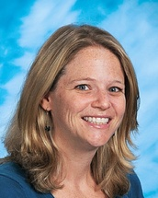
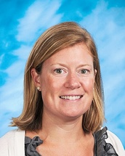
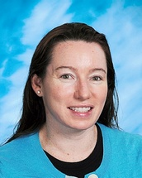
WHO Will Be involved?
First and Second Grade Teachers at RPCS
        Interview
        Data Collection from Curriculum Maps and Lesson Plans
Liz Meredith
1st Grade
Lindsay Saffer
1st Grade
Courtney Fox
2nd Grade
Jenny Greene
2nd Grade

Slide 18

Librarians from AIMS (Association of Independent Maryland Schools), Grades K-5
        Survey
        Data Collection from Lesson Plans and Observations
A statewide association
of over 100 private,
independent and college
preparatory schools.

Slide 19
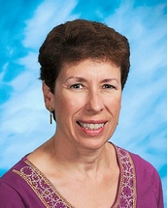
Overseeing the project?
RPCS Lower School Librarian
Beverly Edwards
        Conduct Interviews
        Distribute and Collect Surveys
        Collect Data from Curriculum Maps and Lesson Plans
        Collect Data from AASL Standards
        Analyze Data
        Disseminate Findings
        Make Recommendations
        Initiate Implementation of Plan

Slide 20

WHEN?
Interviews of Teachers – June, 2011
Surveys of Librarians – June, 2011 with request for returns no later than 2 weeks after distribution
Analysis of Curriculum Maps and Lesson Plans – Summer, 2011
Analysis of AASL Standards – Summer, 2011
Dissemination of Findings – September, 2011
Implementation of Recommendations – 2011-2012 School Year

Slide 21
The Tools Involved
1. Interview with First and Second Grade Teachers
Sample Question:
Out of all of the subjects you teach, which one(s) interest you as a potential area for students to conduct research? Are there any particular units that would lend themselves well to this?

Slide 22
2. Survey of AIMS Librarians
Sample Questions:
Have you ever used I-search with students in first or second grade?
If yes, list any lesson(s) and/or project(s):
Have you ever used any aspect of Big6 with students in first or second grade?
If yes, list any lesson(s) and/or project(s):

Slide 23
3. Analysis of Curriculum Maps and Lesson Plans of First and Second Grade Teachers
4. Analysis of Librarians’ Lesson Plans

Slide 24
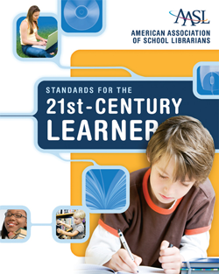
Analysis of Standards for Learning
AASL (American Association of School Librarians)

Slide 25
DISSEMINATION plan
Individual Meeting with Lower School Head
      Verbal and Printed Report of Findings
      Preview of Multimedia Presentation for Faculty
      Recommendations
Meeting with First and Second Grade Teachers
      Discussion of Findings and Recommendations
      Make Plans for Implementation
Lower School Faculty Meeting
      Multimedia Presentation
      Summary of Recommendations and Plans for Implementation

Slide 26
conclusion
All signs point to the fact that there is no reason to wait--teaching basic research skills to students in first and second grade is a worthwhile endeavor that will have a positive impact on student achievement. At Roland Park Country School, we can make this happen! The first and second grade teachers and the Lower School Librarian can work as a team to integrate inquiry-based skills into the existing curriculum. We can glean and adapt ideas from a variety of sources, including the AASL, other K-5 library teachers, and the plethora of information available regarding I-search and Big6. Research is an active process that can be self-directed and satisfying to young students. The time has come for RPCS to give it a try.

